Slide 1
HTML
CINF 201 Fall 2021

Slide 2
Naming Conventions for Files
HTML files should be readable and easy to find.
Best practice is to use only lowercase letters and either hyphens (-) or underscores (_)
Examples of good names:
homework2.html OR homework-two.html OR hw_2.html OR hw2.html
Bad names:
Homework 2.html OR HW2.html OR HomeWork2.html OR hw two.html
If you use a space, it will be escaped as a “%20”.

Slide 3
Hyper Text Markup Language
Describes the structure of the page – think of a skeleton.
There are several tags, each describe different document content
Each tag needs angled brackets surrounding it like this: <tag>
However, ending tags need a slash before the tag name: </tag>
Not all tags need to have an ending: <br/> or <hr/>…slash can be omitted
Tags aren’t case sensitive BUT it is recommended that you use lowercase

Slide 4
Elements & Tags
An element is everything from the start tag to the end tag.
Element content is between the start/end tag.
Not all elements have a closing tag or content.
Examples:
<br> - Break
<hr> - Horizontal rule
<img> - Image

Slide 5
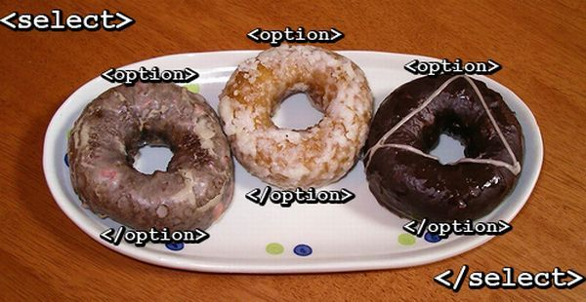

Slide 6
Inline vs. Block Elements
Inline elements take up the width of their content while block level elements take up the entire width of the screen.
Below are links to pages that explain inline elements vs block level elements.
https://developer.mozilla.org/en-US/docs/Web/HTML/Inline_elemente
https://developer.mozilla.org/en-US/docs/Web/HTML/Block-level_elements
You can place inline elements inside of block elements but not the other way around.
<p><a></a></p> is good.
<a><p></p></a> might look normal on the page but it will produce errors.

Slide 7
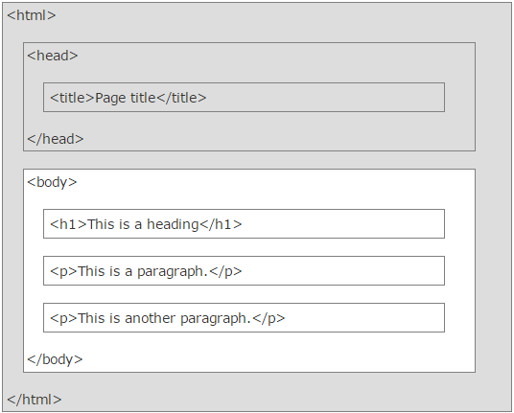
HTML Visual
The image on the right shows a typical layout of an HTML page. The whole document is wrapped in an html tag. Inside of the html tag are two important tags. The head tag is where external resources can be linked. The body tag is what appears on the screen and contains all the visual elements. Tags can be nested meaning that one set of tags is in between another set of tags. The head and body tags are nested inside of the html tags.
The head and body tags are siblings while the html tag is their parent.

Slide 8
General Tags
<!DOCTYPE html> - MOST IMPORTANT!!! It’s an instruction to the browser.
<title> - Appears in the tab in the browser window
<h1> - Biggest heading
<h6> - Smallest heading
<a> - Link
<img> - Image
<strong> - Makes an element bold to signify importance

Slide 9
Other Tags
<ul> - Unordered lists
<ol> - Ordered lists
<li> - List item (it has to be inside of <ol> or <ul> tags)
<em> - Italicize but also place emphasis on the word

Slide 10
Tag Examples
Creating a basic list in HTML
<ul>
<li>List Item One</li>
<li>List Item Two</li>
<li>List Item Three</li>
</ul>
The code above has proper indentation and will be easier for other developers to read.

Slide 11
Tables
The code below creates a table with one row (tr) and 2 columns (td).
<table>
<tr>
<td>Table Data</td>
<td>Table Data</td>
</tr>
</table>
You can also use <th> inside of <tr> to signify table headings. The text inside of <th> tags appears in the table centered and bolded.

Slide 12
Nesting
When a tag is placed inside of another tag, we would say that one tag is nested inside of the other. In the previous slide, the li tags are nested inside of the ul tags.
To nest a list inside of a list:
<ul>
<li>List Item One</li>
<li>List Item Two
<ul>
<li>Sub Item One</li>
<li>Sub Item Two</li>
</ul>
</li>
<li>List Item Three</li>
</ul>

Slide 13
Nesting Explained
Certain tags can only be be nested inside of others. An example would be <em> and <strong>. Generally speaking, inline tags can only surround textual content or other inline tags. Some block tags can appear in other block but not inside of inline tags.
Valid:
<div>
<p><em>This</em> is a <a href=“somewhere.html”><strong>link</strong></a>.</p>
</div>
Invalid:
<em><p>This is some content</p></em>

Slide 14
Special Characters (Symbols)
Some characters can’t be expressed in normal HTML.
Examples:
<
>
&
In order for them to show up, they have to be “escaped”.

Slide 15
Escaping Special Characters
& - &amp;
> - &gt;
< - &lt;
The format is usually an ampersand (SHIFT + 7) followed by the abbreviated code, then a semicolon with no spaces in between either of those parts.
http://www.w3schools.com/html/html_symbols.asp (not always a good source but this is okay)

Slide 16
Attributes
Go on the inside of a tag and allow it to function differently.
Examples:
<a href=“somewhere.html” target=“_blank”></a>
<html lang=“en-US”>
<img src=“picture.jpg” alt=“a picture of something”/>
href, lang, src, and alt are the attributes while the things inside of the quotation marks are values.

Slide 17
Validation
http://validator.w3.org/#validate_by_input
This is the tool you will use to check your pages for errors. Validation is worth 2 points of every assignment with no partial credit.
To use it, you must take your HTML code and copy/paste it into the text box. After you click to check it, errors may or may not appear. If you see a green bar, that typically means you have no errors on your page. Yellow bars serve as a warning and red ones mean there are problems which should be fixed.

Slide 18
Great HTML Resources
http://www.htmldog.com/
http://html5doctor.com/
https://developer.mozilla.org/en-US/docs/Web/HTML
This one used to be a bit inaccurate, but it should also work well. Take everything with a grain of salt with all online resources.
http://www.w3schools.com/html/default.asp

